Slide 1
CSE 301 – History of computing & Ethics
Matthew abbruscato
Nicole ang
David alcantar fadel al-mubarak rizwan ahmad james adamec

Slide 2
Computers Before 1940

Slide 3
First uses of hardware
Roman Abacus – The first device that was used to compute arithmetic was the abacus.
  This was an analog device.
  Used as early as 2400 BC
  Performed Addition and subtraction

Slide 4
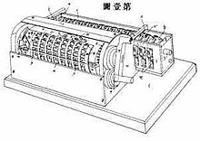
Failed Computing Devices
The computing clock was invented in 1623
  This device used a single toothed gear.
  A fire destroyed the device during its construction and the idea was thrown away.
  drawings for this device were discovered in the 50’s but it really had no impact on the computing industry

Slide 5
The Early 1800’s
Punch card technology
  Mechanical Loom
    developed by Joseph-Marie Jacquard
    The pattern woven by the loom is controlled by the punch card

Slide 6
The late 1800’s
Punch cards used as storage devices
  Invented by Herman Hollerith
  He invented the Tabulator, and the Key punch machine to utilize the punch cards
  The Tabulator was used to add punched cards
  The United States Census used these punch cards to complete their results months ahead of schedule
  Hollerith’s company soon became the core of IBM

Slide 7
Adding Machines
Standard Adding Machine Company
  10 key adding machine released in 1901
  Invented by William Hopkins
  All 10 keys were in a single row
Dalton Adding Machine -1902
  First 10-key printing adding machine with 10 keys in two rows only six made by 1907

Slide 8
Other Milestones
1906-Vacuum tube aka the Thermionic Valve
  Invented by Lee De Forest
1906-Hollerith made a plugboard for his tabulator which was re-wireable to adapt the machine for different uses, used in direct machine calculations until overtaken by stored programs in the 1950s
1919 First Flip-flop circuit design

Slide 9
Logic Gates
Walther Bothe built the first AND logic gate
  used in physics experiments
  Received the Nobel Prize in Physics in 1954 for it despite Nikola Tesla’s using the same technology in the submarine teleautomaton built in 1899 which he held the patent for

Slide 10
IBM 601 Multiplying Punch-1931
  This machine read two numbers, up to 8 digits long and punched their product into a punchcard
Alan Turing-1936
  Published his paper on ‘computable numbers’ which addressed the ‘Entscheidungsproblem’ whose solution was sought by reasoning about a simple and theoretical computer which we call a Turing Machine.

Slide 11
George Stibitz made a demonstration of a 1-bit binary adder using relays.
  This was the first binary computer, even though it was only used for demonstration
  Improvements on this machine lead to the Complex Number Calculator in 1940

Slide 12
Z1
Konrad Zuse of Berlin made the first mechanical binary programmable computer
Based on Boolean Algebra and had the most basic of parts used in modern machines
  it used the binary system and separated storage and control
Worked with floating point numbers

Slide 13
Z1 -cont
Used sliding metal parts to store 16 numbers
The arithmetic unit didn’t work very well
  Suffered occasionally from mechanical problems
Program read from holes punched in discarded 35mm movie film
  Data values were entered on a numeric keyboard
  Outputs displayed via electric lamps
It couldn’t do loops
  Wasn’t “Turing complete” because of this

Slide 14
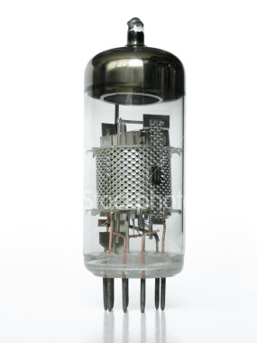
John Vincent Atanasoff and Clifford Berry
  Made the first prototype 16-bit Adder
  It used vacuum tubes to calculate and was the first to do so

Slide 15
Z2
Combined the existing parts of the Z1 with a new arithmetic unit that used relay logic
The Z2 also lacked loop capabilities making it still unable to be Turing Complete

Slide 16
Helmut Schreyer
Made the first 10-bit adder using vacuum tubes
Also made a prototype memory using neon lamps

Slide 17
History of Computing < 1940s

Slide 18
1943
Grace Hopper started to develop a series of base codes for bit sequences that programmers frequently used. These codes were given labels and were eventually called pseudocode or opcode and led to development of more high level programming languages.

Slide 19
1945
John Von Neumann developed 2 concepts that changed the development of programming languages.
  “Shared-program technique” declared that computer hardware should be simple and shouldn’t be hand-wired for each program
  “Conditional control transfer” was an idea that subroutines or small blocks of code could be executed in any order instead of having the computer work through each line one at a time.

Slide 20
1950
The Turing Test
  Alan Turing published the paper “Computing Machinery and Intelligence.” In it, he stated that computers could eventually be programmed to possess human-like intelligence.
  He discussed possible problems and solutions for developing artificial intelligence.
  He proposed a test in that if a human interrogator was unable to determine if he/she was conversing with a human or computer, then the computer could be considered intelligent. This test later became known as the Turing Test.

Slide 21
1952
Concept of subroutines
  Developed Maurice Wilkes, Stanley Gill, and David Wheeler
  Pieces of code that can be used multiple times in different places of a larger program.
  Sped up the development of software

Slide 22
1958
The International Algebraic Language was designed
  Later called ALGOrithmic Language (ALGOL)
  The formal syntax of the language was set in 1960
  It introduced the concept of block instruction, later called procedures.
    Niclaus Wirth used this concept and formed PASCAL in 1970

Slide 23
1960
The Perceptron.
  Frank Rosenblatt created this algorithm to learn through trial and error and tried to imitate the thought processes in humans
  1st computer model of neural networks
  Used as a basis for more complex neural networks and pattern recognition

Slide 24
1963
ASCII, American Standard Code for Information Interchange, was developed
  Before, each company coded their computers a different way. Translation tables were needed to exchange data between different brands
  After ASCII became the standard character coding, the translation tables were no longer needed. This in turn made it easier to transfer data between different types of computers

Slide 25
1968
The concept of Software Engineering
  Computer hardware was rapidly developing and software development was unable to keep up due to overly complicated programs that were difficult to fix and maintain
  The Garmisch Conference created methods and models to form a more structured software development process. This made it easier to understand and manage large programs as well as reduce the number of errors made during development.
  Work focused on improving such processes were separated into its own field, software engineering.

Slide 26
1973
Nassi-Schneiderman diagram
  Isaac Nassi and Ben Schneiderman developed a diagramming technique that created a graphical representation of a program or algorithm.
  It produced a simpler design than a flowchart
  Mostly used to provide a general outline to a process as a whole and reduce a large program into smaller parts that are easier to analyze

Slide 27
1975
PROMPT II
  Project, Resource, Organization, Managment and Planning Technique
  Methodology created by Simpact Systems Ltd to stop the disorder of software development.
  Created a basic method of delivering a project by a deadline and in budget
  Slowly evolved into PRINCE, PRojects IN Controlled Environments
  Used mostly in Europe

Slide 28
History of Computing
1980s to Present

Slide 29
1980 – Development of DOS OS
In October 1980, Microsoft received a commission from IBM to begin developing their first Operating System, MS-DOS 1.0.
Previously, no PC OS existed, Microsoft purchased DOS and coded it further.
Very basic. Only a single directory existed, the root. Sub-directories were not implemented until the second revision.

Slide 30
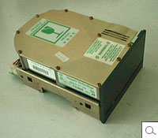
1980 – Disk Storage
Seagate Technology develops the first microcomputer hard disk drive.
Only 5 megabytes of data! In comparison, 30 years later common PC hard drives contain up to 400,000 times that amount. (2 Terabytes)

Slide 31
1981 – The First PC
In August 1981, IBM unveils the first Personal Computer.
Ran MS-DOS 1.0, with a 4.77 MHz Intel Processor.
IBM received 100,000 orders by Christmas. Their model paves the way for the modern PC seen today.

Slide 32
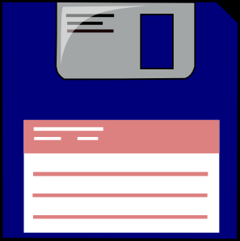
1981 - Notable
September – TCP/IP standard is established. This protocol carries most of the common information that travels across the internet.
Sony introduces the first 3 ½” floppy drive
Previously, floppy disks were only as small as 5 ¼”

Slide 33
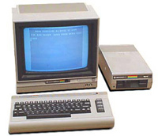
1982 – Arrival of PC Gaming!
The Commodore 64 is released. Boasts 64 KB RAM and “impressive” graphics.
Sold 22 million units before discontinuation!

Slide 34
1983 – Enter Apple, Internet
Apple releases the first PC with a GUI, known as Lisa.
Due to hardware limitations and price ($10,000), Lisa fails in the PC market
The military “internet” known as ARPANET splits into two sectors, private and civilian. The dawn of the modern internet!
Not possible without TCP/IP from 1980

Slide 35
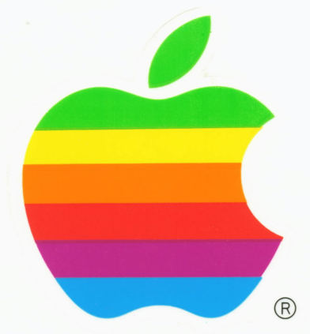
1984 – Apple: Round Deux
Apple Computer introduces their first Macintosh PC.
It is the first successful PC driven by a mouse with a GUI.
Haters and fanboys alike created from this point forward

Slide 36
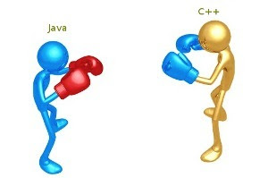
1985 – C++
C++ becomes the dominant object oriented programming language for its time.
Has no idea Java will crush its hopes and dreams in the future
Windows is launched,
though not as a
complete OS.

Slide 37

1988 – Can of Worms Opened
23 year old Robert Morris sends first self-replicating worm through ARPANET.
Infected about 10% of the hosts connected to the network.
Receives probation, community service, and a $10,000 fine.

Slide 38
1990 – WWW & Windows
Tim Berners-Lee, a CERN researcher, develops Hypertext Markup Language (HTML).
When combined with ARPANET, creates the internet as we know it today
Windows 3.0 debuts, the first popular Windows OS that allowed large scale GUI applications that could be run simultaneously
Still requires DOS (Booooo)

Slide 39
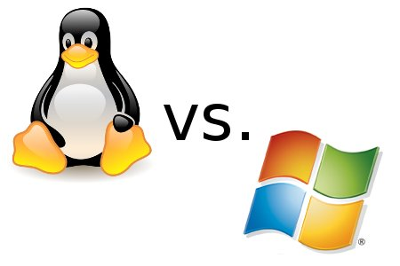
1991 – Linus’s Linux
In September, Linus Torvalds releases the first Linux kernel.
Developers began improving Linux, and seven years later is known as the first “Open Source” OS.

Slide 40
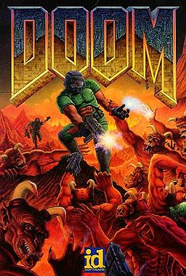
1993 – Yes.
id Software releases “Doom.” PC gaming gets serious.

Slide 41
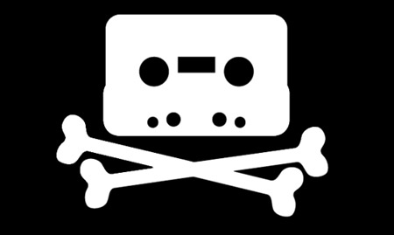
1993 - Seriously
The MP3 file format is published. Today, music piracy is one of the biggest ethical battles in computing
Intel releases the first Pentium processor. Achieves speeds up to 66 MHz.

Slide 42

1995 – Java & Script
Java is announced by Sun Microsystems
Will prove to be a future rival to C++ in object-oriented programming
NetScape announces its development of JavaScript, a web programming language with Java-like syntax

Slide 43

2000 – Speed and Space
Intel has a limited release of its first 1 GHz Pentium III chips
Two years later, hard disk drives larger than 137 GB become possible due to new addressing space solutions.

Slide 44
Today: Development
One year ago, the first 4 Terabyte hard disk drive was made
Intel and other manufacturers market multi-core processors in excess of 3.8 GHz with potential for higher speeds
Data transmission has become easier due to the proliferation of wireless internet and the increasing portability of computers

Slide 45

Today: Controversies
With the increase in data availability also comes an increase in data sharing
Music and software piracy is a growing problem with many facets
“Wild West” frontier days of the internet are being threatened

Slide 46
History of the Internet

Slide 47
Early NETWORKS
ARPANET
  Avoid doubling research
  speed up the sharing of information
Rand corporation
  US Military Network
National Physical Laboratory
  Financial Network
Cyclades
  French Scientific Network

Slide 48
ARPANET
Used a mainframe and an Interface Message Processor (IMP)
The IMP controlled the network activity
Mainframe in charge of initialization of programs and data
Used Network Control Protocol (slow)

Slide 49
National Physical Laboratory
Expected a lot of users and wanted to avoid congestion
Packet Switching
  Divided send files into small parts
  Gave rise to several transmission protocols such as TCP and UDP

Slide 50
Cuban Missile Crisis and networks
Networks communicated using radio waves
  A nuclear explosion would cause interference
  Developed short range waves that used a distributed network
Networks used centralized nodes for data
  If one node was knocked out the entire system would go down
  Decentralized nodes
    Multiple node connections to prevent network crash

Slide 51
Cyclades Network
Cyclades used smaller networks in multiple places
Focused on communications between networks
This is how the term Inter-net was created
Instead of processing data at each computer node in a network they just forwarded the information

Slide 52
Server based networking
Before, telephone companies had the X.25 network which allowed users to pay for access to multiple networks
DARPA eliminated this infrastructure with server based networks running the Transmission Control Protocol (TCP) developed in 1980

Slide 53
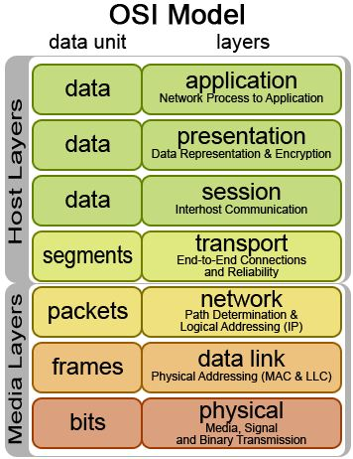
OSI Model
International Organization for Standardization creates the Open System Interconnection networking model in 1977
Divides the networking channel into separate layers
Gave way to the TCP/IP protocol (modern internet!)
Guaranteed inter-network compatibility

Slide 54
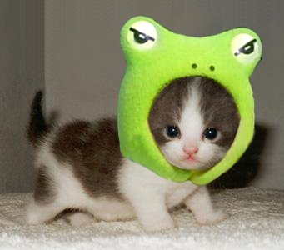
Cat break

Slide 55
History of the Web

Slide 56
Origin of the Web
Tim Berners-Lee from CERN tackling the problem of sharing data with scientists around the globe
Current systems were inefficient
  Not standardized at all
  Required certain systems to access
Web provided a nice alternative, but had a hard time catching on
  Started as a way to share phone numbers within CERN

Slide 57
Propagation of the Web
Web was made available to the public in 1991
  Allowed more publicity among the scientific community
  Also allowed for outside development
Stanford Linear accelerator Center (SLAC) used it to publish abstracts
  So successful that people in Europe would connect to use it

Slide 58
The Web Booms
At first was competing with the Gopher Protocol from the University of Minnesota
Two main developments allowed the Web to come ahead:
  Marc Andreessen creating Mosaic
    First web browser for Windows
  Gopher charging for their service
Natural evolution of the web allowed it to become what it is today

Slide 59
History and Overview of Computer Ethics

Slide 60
Defining Ethics
Many different terms used to describe ethical issues involving computers
  Computer Ethics: “Describes the field that examines moral issues pertaining to computing and information technology”
  Information Ethics: “Refers to a cluster of ethical concerns regarding the flow of information that is either enhanced or restricted by computer technology”, also called Internet Ethics
  Cyber Ethics: Includes the above, in addition to issues involving “privately owned computer networks and interconnected communications technologies”

Slide 61
Why Cyber Ethics?
More accurate term than computer ethics
  Computer ethics implies a stand alone machine, rather than an interconnected medium
  Computer ethics implies issues that only affect computer professionals
More accurate than Information/Internet Ethics
  Information ethics can involve non computer issues
  Internet ethics doesn’t account for ethical issues offline

Slide 62
Brief History of Computers and Ethics
Computer ethics founded by Norbert Wiener during WWII
  Developed cybernetics to build an antiaircraft cannon
  Foresaw there could be future social and ethical consequences involving cybernetics, wrote Cybernetics: or, Control and Communication in the Animal and the Machine
  Wrote Human Use of Human Beings, established first ideas of computer ethics

Slide 63
Phase 1 of Cyber Ethics
1950s and 60s
Early questions relating to artificial intelligence
  Can computers think? Should we make computers than can think? What separates thinking computers from humans?
Surveillance Issues
  “Big Brother”; nationwide databases used to monitor citizens

Slide 64
Phase 2 of Cyber Ethics
1970s and 80s
Questions from Phase 1 still relevant
Issues of this phase include computers used to commit crimes, debates over software piracy and intellectual piracy (is it still stealing if you can make infinite copies of something?), and privacy issues

Slide 65
Phase 3 of Cyber Ethics
1990s to present
Issues from previous phases still relevant
Invention of the Internet and World Wide Web brings new cyber ethics issues up for debate
  Free speech online?
  Anonymity?
  Where is jurisdiction for crimes committed in “cyberspace”?

Slide 66
Phase 4 of Cyber Ethics
Present day to the near future
All issues from previous phases still important
Artificial Intelligence, “smart objects” wirelessly communicating with each other
Nanotechnology and biocomputing leading to new levels of synthesis between man and machine
Pervasive nature of technology

Slide 67
Recap
Different terms to describe ethics and computers, depending on which aspect you most want to focus on
Norbert Wiener, father of computer ethics
Computer ethics can be broken up into 4 phases: 50s and 60s, 70s and 80s, 90s to present, and present to future
  Issues from previous phases are still relevant today

Slide 68
Works Cited
Bynum, Terrel. "A Very Short History of Computer Ethics." . American Philosophical Association, Summer 2000. Web. 9 Sep 2012. http://www.southernct.edu/organizations/rccs/oldsite/text-only/resources_t/research_t/introduction_t/bynum_shrt_hist_t.html
Tavani, Herman. Ethics and Technology: Controversies, Questions and Strategies for Ethical Computing. 3rd Edition. John Wiley and Sons Inc., 2011. 3-8. Print.

Slide 69
Works Cited
http://www.thocp.net/timeline/
http://www.turing.org.uk/turing/scrapbook/test.html
http://www.psexam.com/Notes-for-Computer-Science/operating-systems-history-of-operating-system-article/1960s-%E2%80%93-Garmisch-Conference-The-Concept-of-Software-Engineering.html
http://en.wikipedia.org/wiki/Nassi%E2%80%93Shneiderman_diagram
http://www.edrawsoft.com/Nassi-Schneiderman.php
http://www.prince2.com/what-is-prince2.asp

Slide 70
Works cited
http://www.computerhistory.org/timeline/
http://en.wikipedia.org/wiki/Timeline_of_computing_1980%E2%80%931989
http://en.wikipedia.org/wiki/Timeline_of_computing_1990%E2%80%931999
http://en.wikipedia.org/wiki/Timeline_of_computing_2000-2009
http://en.wikipedia.org/wiki/History_of_hard_disk_drives
http://inventors.about.com/od/computersoftware/a/Putting-Microsoft-On-The-Map.htm
http://inventors.about.com/library/weekly/aa043099.htm
http://inventors.about.com/library/weekly/aa051599.htm
http://inventors.about.com/od/mstartinventions/a/Windows.htm
http://upload.wikimedia.org/wikipedia/en/5/57/Doom_cover_art.jpg
http://upload.wikimedia.org/wikipedia/commons/2/2b/Osi-model.png

Slide 71
Works Cited
http://netforbeginners.about.com/od/internet101/f/the_difference_between_internet_and_web.htm
http://computer.howstuffworks.com/internet/basics/internet-versus-world-wide-web.htm
http://www.webopedia.com/DidYouKnow/Internet/2002/Web_vs_Internet.asp
http://www.w3.org/DesignIssues/TimBook-old/History.html
http://news.bbc.co.uk/2/hi/technology/5242252.stm

Slide 72
Discussion points
History
  According to Moore’s Law, technology is improving at an exponential rate by the year.
  From what you’ve seen, do you believe this trend will continue? Why or why not?

Slide 73
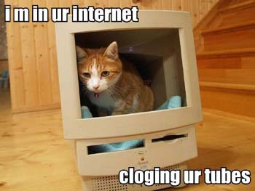
Discussion points
Internet / Web
  How did the sharing of information over the web fuel technology-assisted plagiarism?
  Does a generational-gap play a role in this viewpoint?

Slide 74
Discussion Points
Ethics
  What ethical problems arise from widespread sharing of files?
  Think Music, Software, Intellectual Property

